Slide 1

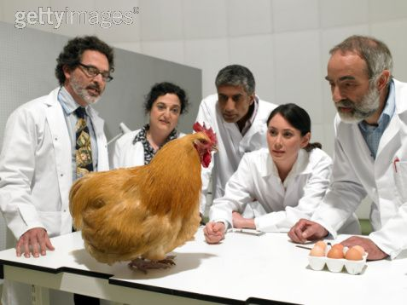

Project Title Collin Erickson, Northwestern University Dr. Susan Sanchez, at the Naval Postgraduate School
Important Note:
All final submissions MUST be submitted in PowerPoint (.pptx) Format!
Overview
Results
In this section, use two – four sentences to represent your project. Include the research question, background information, and purpose of your project.
Your results section will be comprised of the outcomes and the end products achieved over the course of your research project. The graphic below provides further information.
Describe the components of the project that had results that were expected. What ideas or assumptions were put to the test and were proven true?
Hypothesis and Approach
This is the section of your research poster that will be used to elaborate on your assumptions and how you approached the project itself. When considering what to write here, think about:
what questions were asked to start this project,
what assumptions you made,
how you answered those questions, and
how you set about to test those assumptions.
This could include the questions/assumptions mentioned above!
Chart With Results
Use bullet points to effectively emphasize certain elements of your project.
Describe the components of the project that had results that weren’t expected. What ideas or assumptions were put to the test and were proven false?
These are caption examples. Captions provide context directly related to the graphic you are utilizing. Font size should be 18.
Describe the outcome specifically. Describe the factors that contributed to the outcome including mistakes, unforeseen consequences, and the unknown.
Figure 1. A group of actors in lab
coats stare intently at a chicken.
Future Research Plans
Figure 2. An actor in a lab coat inhales deeply prior to falling unconscious for not using sufficient inhalation protection… or common sense.
This portion of the research poster will focus on the future of the project. Has all of the research involved here been completed? If not, this is your opportunity to describe where this project is going and how it is getting there.
Use this space to inform the reader about the project’s roadmap. Where is it going? What changes and modifications will be made to make progress towards the research goal you have specified?
Methods and Materials
This portion of the research poster will focus largely on how you were able to conduct your project.
What resources did you use?
What processes did you learn and implement?
Acknowledgements
This last section of the research poster gives you the opportunity to thank all of the faculty, students, fellow interns, and people that contributed to your work and/or made your research possible.
Please Add Your Contact Information (non-NPS) Here

